Slide 1

Marketing/advertising firm

Slide 2
~No Pity for This Fool~
STUDENT: ___________________
BUS 347 Legal Environment of Business
CASE PRESENTATION

Slide 3

Ask Yourself
Copyright Infringement?
- As a general matter, copyright infringement occurs when a copyrighted work is reproduced, distributed, performed, publicly displayed, or made into a derivative work without the permission of the copyright owner.
Putting Someone in False Light?
-False light laws are "intended primarily to protect the plaintiffs mental or emotional well-being." If a publication of information is false, then a tort of defamation might have occurred. If that communication is not technically false but is still misleading, then a tort of false light might have occurred.

Slide 4

Ask yourself
Is Someone’s Image Being Used for Commercial Benefit?
-Although the right of publicity is frequently associated with celebrities, every person, regardless of how famous, has a right to prevent unauthorized use of their name or image for commercial purposes. However, as a matter of practice, right of publicity suits are typically brought by celebrities, who are in a better position than ordinary individuals to demonstrate that their identity has commercial value.

Slide 5
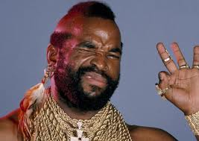


The case
VS.

Slide 6

The case
The lawsuit accuses Best Buy of allegedly altering a “noble and serious” boxing sequence from Rocky III, by digitally removing Sylvester Stallone and making it appear as if Mr. T was boxing a “middle aged, balding, out-of-shape” Best Buy Salesman.
“At no time did Mr. T consent to Best Buy’s use of his likeness, photograph and voice … to promote Best Buy.”
“Best Buy’s portrayal of Mr. T as a fool thus has the likelihood of injuring Mr. T’s business reputation and of diluting the distinct quality of Mr. T’s professional persona.”

Slide 7
You be the judge
http://youtu.be/7LlqMgc11LM

Slide 8
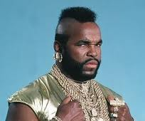
Think about it
Was the scene altered to make Mr. T look like a fool in a malicious manner?
Or was the scene meant to be light hearted?
If you were a leading electronics company would you presume that Mr. T is working for Best Buy?
The Big Question
Could this ruin any future endorsements that Mr. T could obtain?

Slide 9
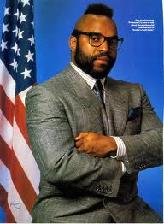
The facts
Mr. T is not the actual owner of the material that was altered.
Mr. T is in fact a public figure, therefore…
- A public figure cannot base a lawsuit on incorrect harmful statements unless there is proof that the writer or publisher acted with actual malice (knowledge of falsity or reckless disregard for the truth). The burden of proof in defamation actions is higher in the case of a public figure

Slide 10

The verdict
What do you think?

